Slide 1

Analysis and Prediction of Large Amount of Sales Data in Supermarket Using Hadoop and Machine Learning
Md GOLAM MORSHED
ID: 2019310147

Slide 2
Agenda
Motivation
Problem Statement
State-of-the-art Solution
Proposed Solution
Improvements
Experimental Results

Slide 3
Motivation
Stores all around the country
Lots of items
Lots of category
Huge Sales data(Big Data) is generating from each store everyday
Analyzing this huge data and predicting upcoming sales is really tough!
Need to build a model for prediction using historical data.

Slide 4
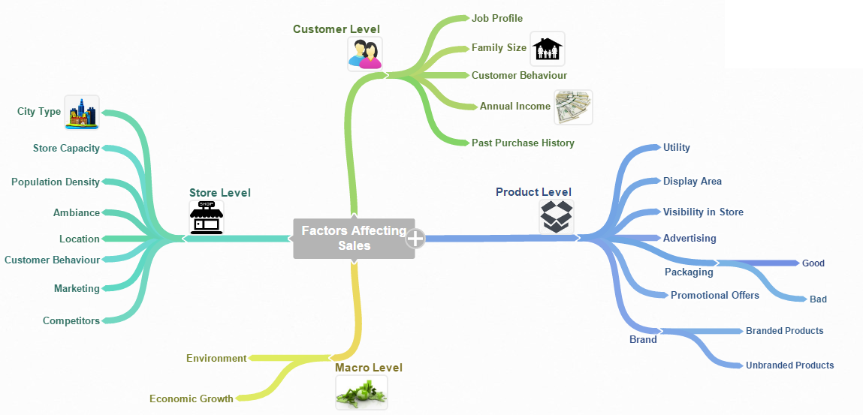
Motivation
Source: Analytics Vidhya

Slide 5
Problem Statement
Need to Store and process sales data of each item in each store
Need to predict upcoming sales for specific item in different store.
Available Data: It is not possible to consider all the factors because of data availability
Need to build a model with available data which can forecast the upcoming sales

Slide 6
State of Art
There are some solution available in different language
Most of the approaches for small amount of sales data
Very less resources are available for big data processing of sales
As per my knowledge no solution using Hadoop distributed file system

Slide 7
Proposed Solution
HDFS and Choosing appropriate Machine Learning:
HDFS could be the best solution for storing and managing
Supervised Learning task: we have to collect labeled training data (e.g. we already know some of the sale price, for some products and stores).
Regression task: our algorithm is expected to predict the sale price for a given product and store.

Slide 8
Solution Workflow Chart
Sales Data Collection
Data Pre Processing
Data Ingesting
(HDFS)
Choosing ML Model
Big Data
Prediction
Parameter Tuning
Evaluate Model
Train Model
(Spark ML)
Big Data Processing with PySpark

Slide 9




Proposed Architecture
Prediction
PySpark
Machine Learning
Mapreduce
Spark
HDFS, Hbase
Storage

Slide 10
Improvement
Many Machine Learning models can be applied on these big data
Cross validation can be performed to check improvements
Four Spark ML model has been used
Linear Regression Model
Ridge Regression Model
Decision Tree Model
Random Forrest Model

Slide 11
Parameters from Dataset
Name | Type | Subtype | Description | Segment | Expectation
Item_Identifier | Numeric | Discrete | Unique Product ID | Product | Low Impact
Item_weight | Numeric | Continuous | Weight of product | Product | Medium Impact
Item_Fat_Content | Categorical | Ordinal | Wether the product is low fat or not | Product | Medium Impact
Item_Visibility | Numeric | Continuous | % of total display area in store allocated to this product | Product | High Impact
Item_Type | Categorical | Nominal | Category to which product belongs | Product | High Impact
Item_MRP | Numeric | Discrete | Maximum Retail Price (list price) of product | Product | Medium Impact
Outlet_Identifier | Numeric | Discrete | Unique Store ID | Store | Low Impact
Outlet_Establishment_Year | Numeric | Discrete | Year in which store was established | Store | Low Impact
Outlet_Size | Categorical | Ordinal | Size of the store | Store | High Impact
Outlet_Location_Type | Categorical | Ordinal | Type of city in which the store is located | Store | High Impact
Outlet_Type | Categorical | Ordinal | Grocery store or some sort of supermarket | Store | High Impact
Item_Outlet_Sales | Numeric | Discrete | Sales of product in particular store. This is the outcome variable to be predicted | Product | Target

Slide 12
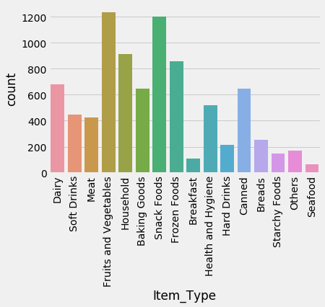
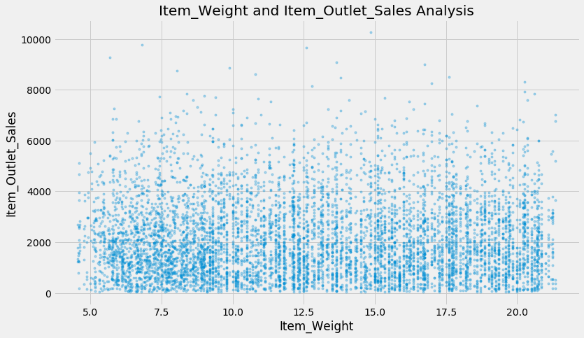
Data Analysis

Slide 13
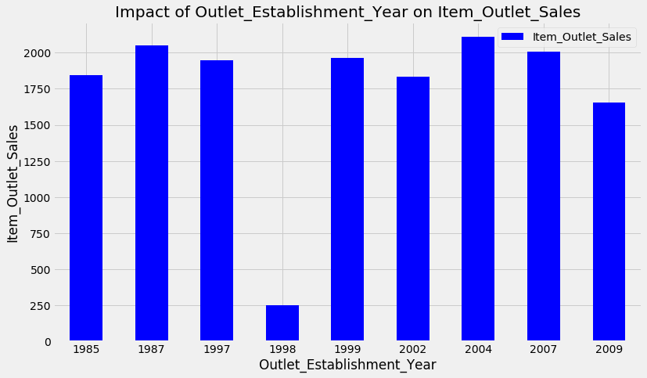
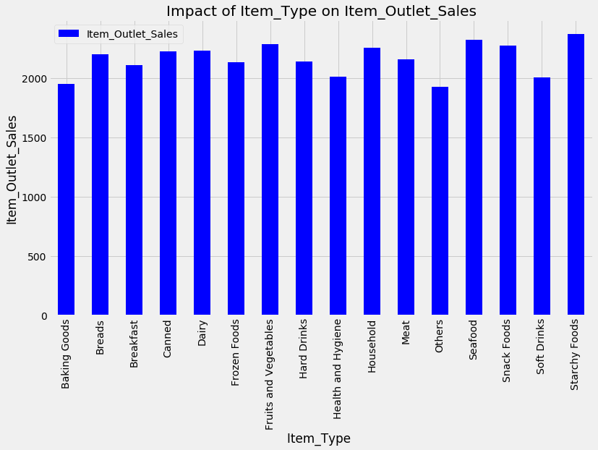
Data Analysis

Slide 14
Experiment Result
Evaluation Criteria:
RMSE :
Root Mean Square Error (RMSE) is the standard deviation of the residuals (prediction errors).
Residuals are a measure of how far from the regression line data points are.

Slide 15
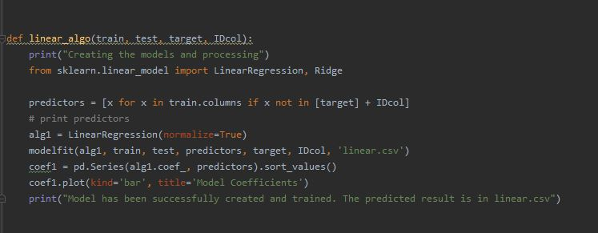
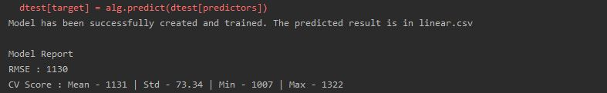
Experiment Result
Linear Regression Model
Output
Code
OutPut File: linear.csv

Slide 16
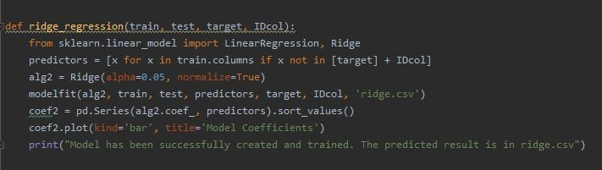
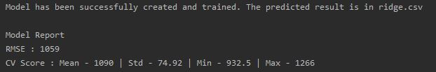
Experiment Result
Ridge Regression Model.
Output
Code
OutPut File: ridge.csv

Slide 17
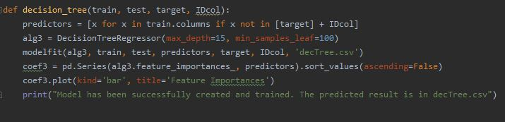
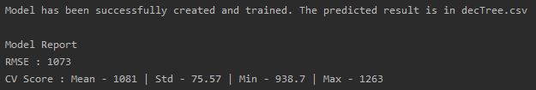
Experiment Result
Decision Tree Model.
Output
Code
OutPut File: decTree.csv

Slide 18
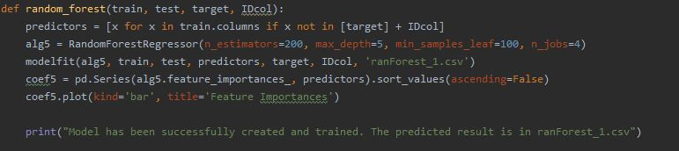
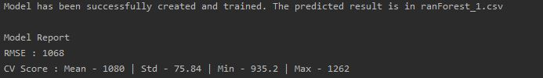
Experiment Result
Random Forrest Model.
Output
Code
OutPut File: ranForest_1.csv

Slide 19
Comparison of Model

Slide 20
Thank You

